Slide 1
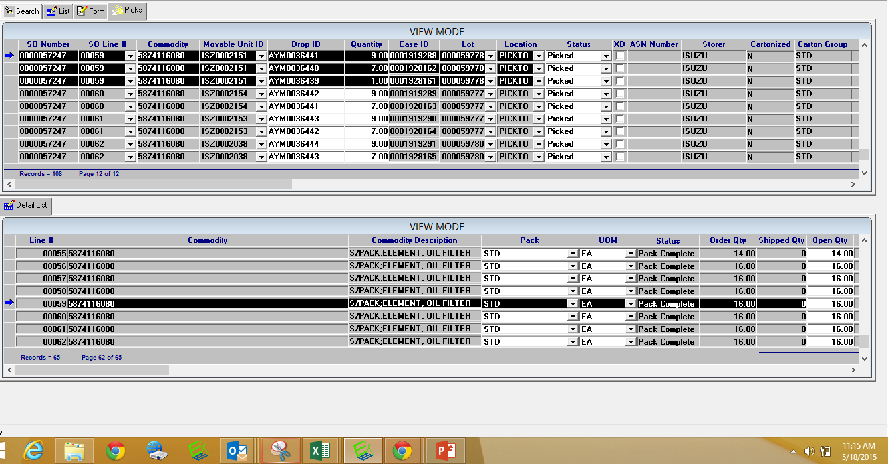
}
LINE # 00059 PICKS SHOWING 17 PCS
LINE # 00059 PICKS SHOWING 16 PCS
}

